Slide 1

Introduction
Presented by Ronnie Mckenzie

Slide 2


2018
Understanding
Leakage
By
Ronnie Mckenzie

Slide 3
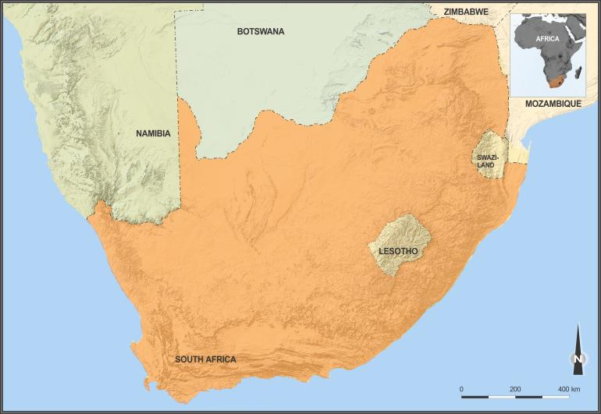
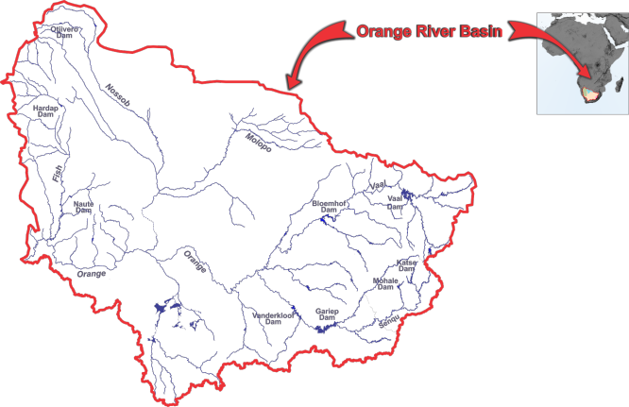
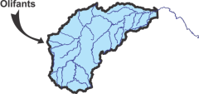


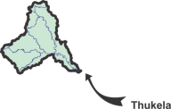

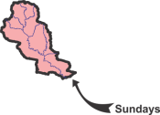

Slide 4
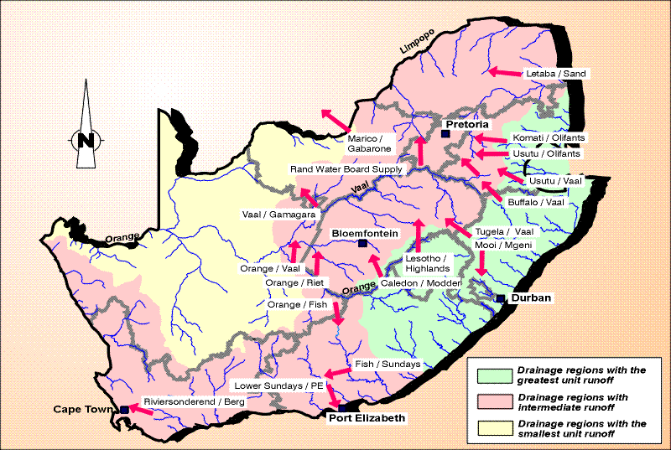
Major Interbasin Transfer Schemes in SA
Major transfers in South Africa
Notes:
Notes:
As a result of the skewed distribution of water resources and the high demands in the central interior of South Africa, many inter-basin transfers schemes have been developed.
Each arrow represents a transfer.
The purpose is to move water from areas of surplus to areas of deficit.
The transfer schemes are large and very expensive.
It is expected that upon completion, Phases 1a and 1b of the Lesotho Highlands Water Project will cost in excess of $ 3 billion (at today’s prices).

Slide 5
Storage at 12 Oct 2016
16167 = 50%
Slide Courtesy Malose Ngoepe from DWS : Hydrology

Slide 6
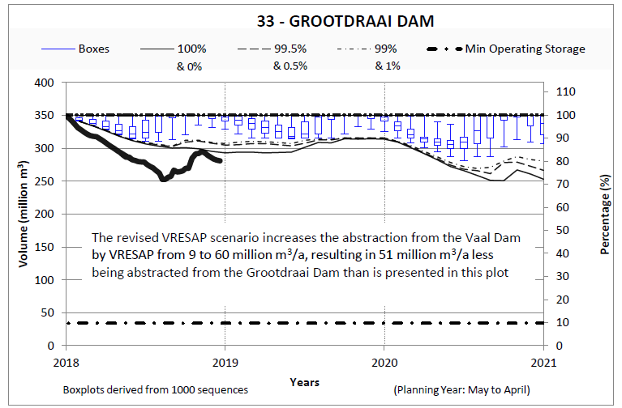
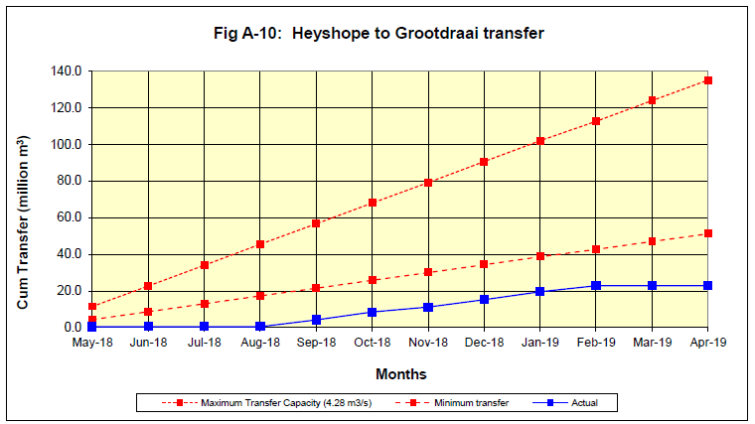
April 2019 Monitoring Report
6

Slide 7
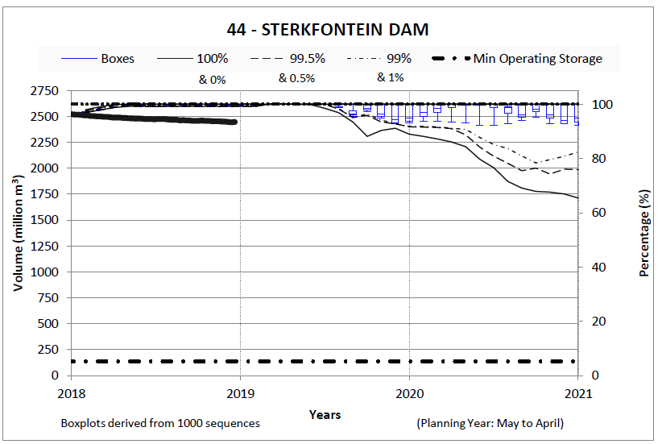
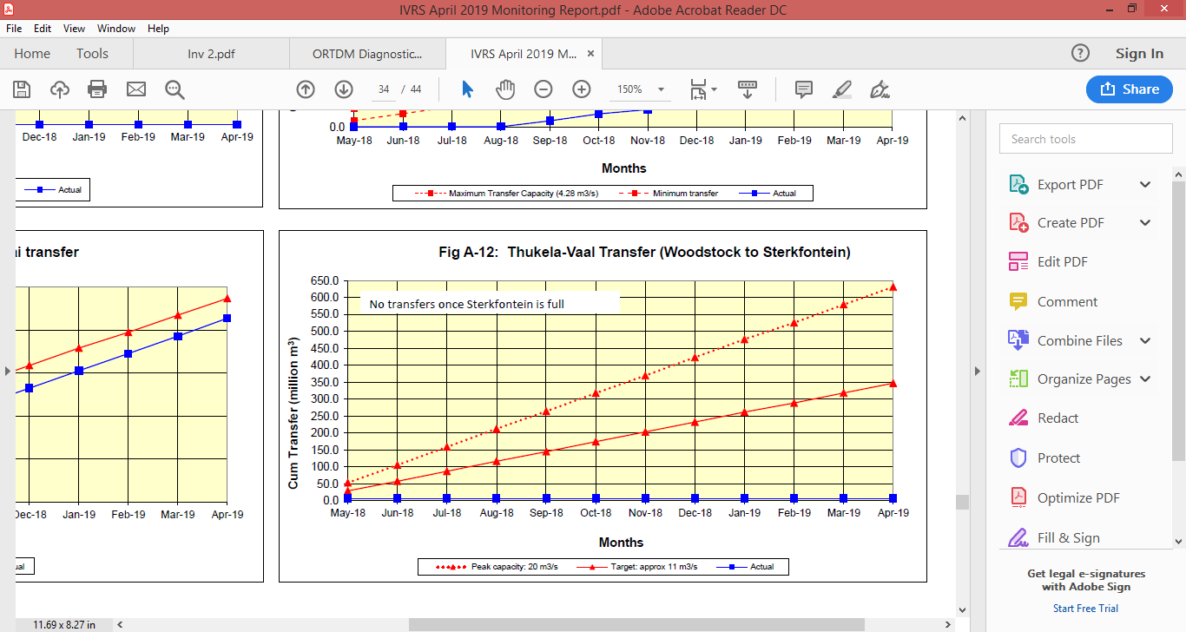
April 2019 Monitoring Report
7

Slide 8
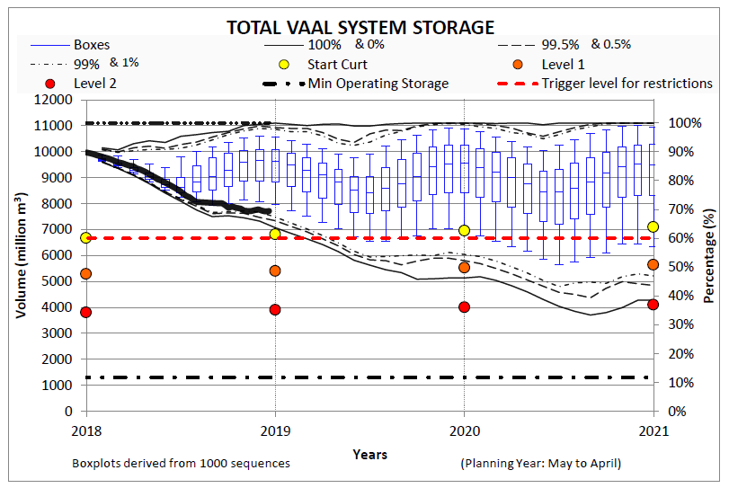
April 2019 Monitoring Report
8

Slide 9
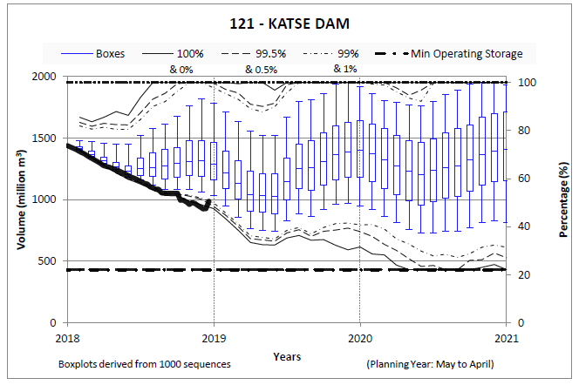
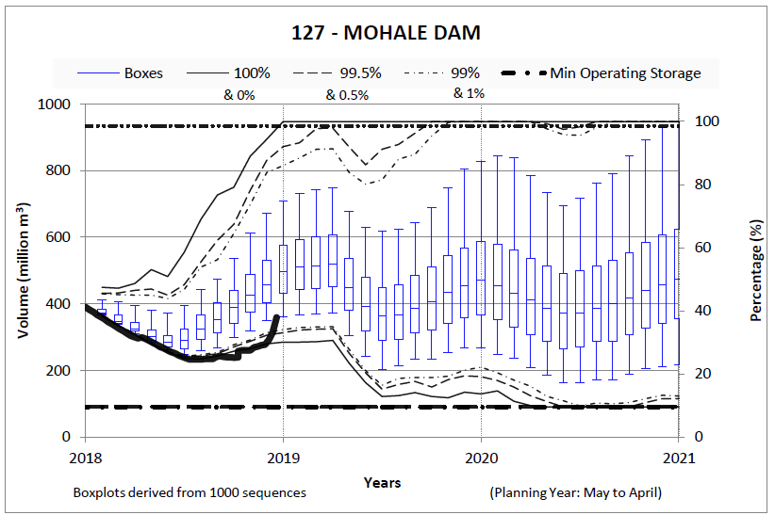
April 2019 Monitoring Report
9

Slide 10
Vaal System Storages: June 2019

Slide 11
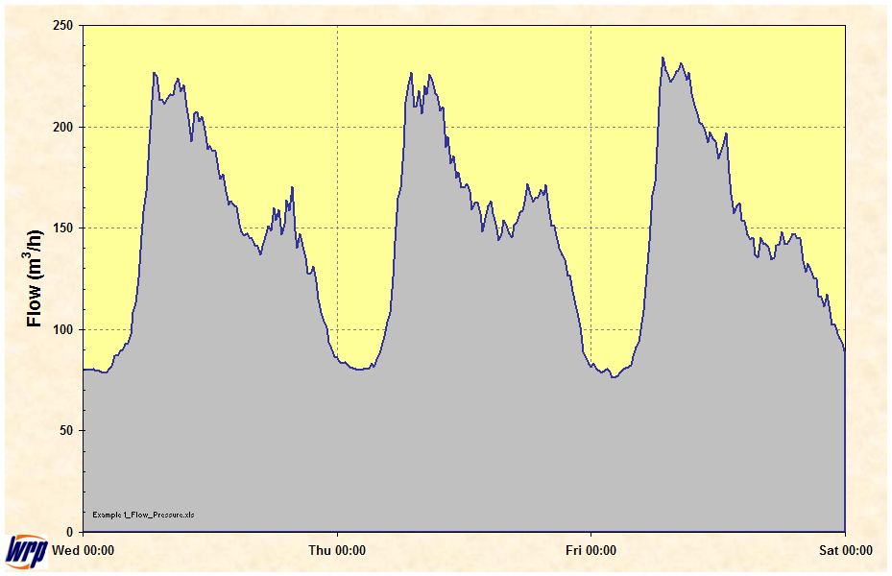
Typical flow logging: 3 days
Flow

Slide 12
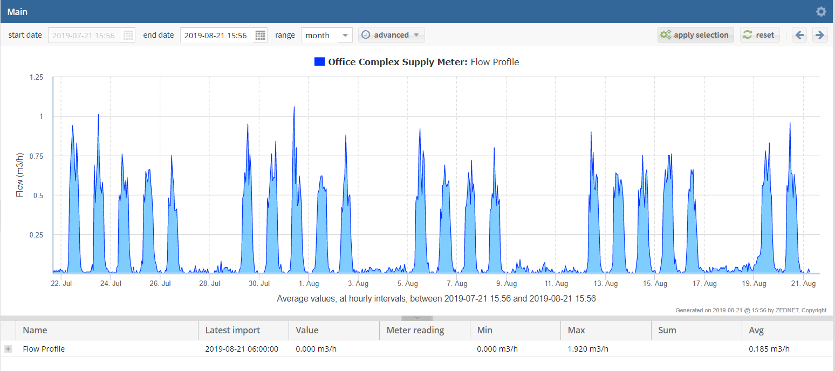
Office Complex: 4 week logging showing no problems for whole month

Slide 13
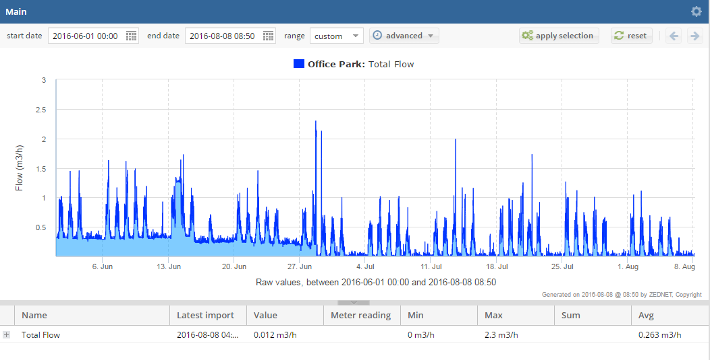
Office Complex: 10 week logging showing 80% reduction in water use as leaks repaired
Normal Weekday demand
Normal Weekend demand
First small leak repair
Main leak repair
Initial Leakage
No Leakage

Slide 14
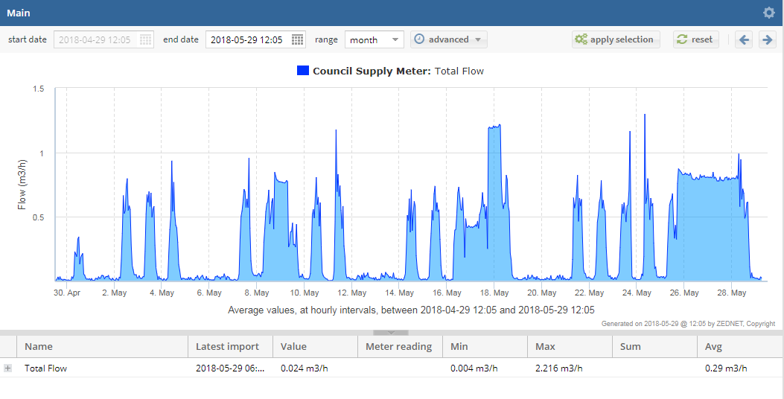
Office Complex: 4 week logging showing toilet cistern sticking

Slide 15
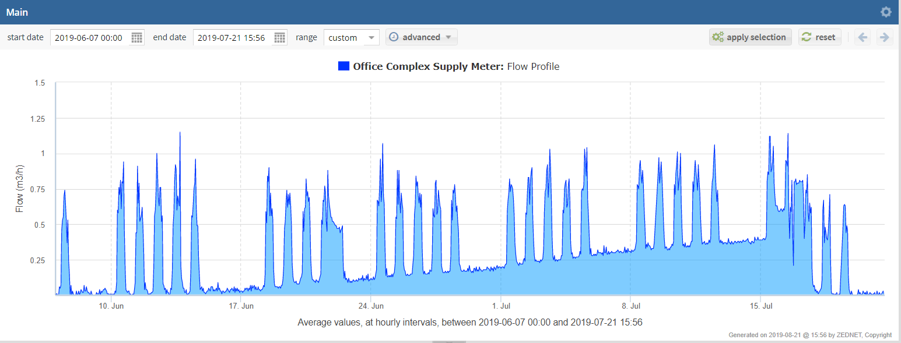
Office Complex: 6 week logging showing leak developing and repair

Slide 16
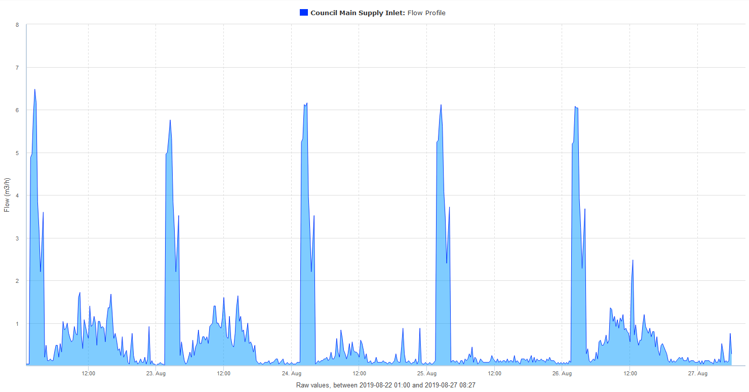

Slide 17
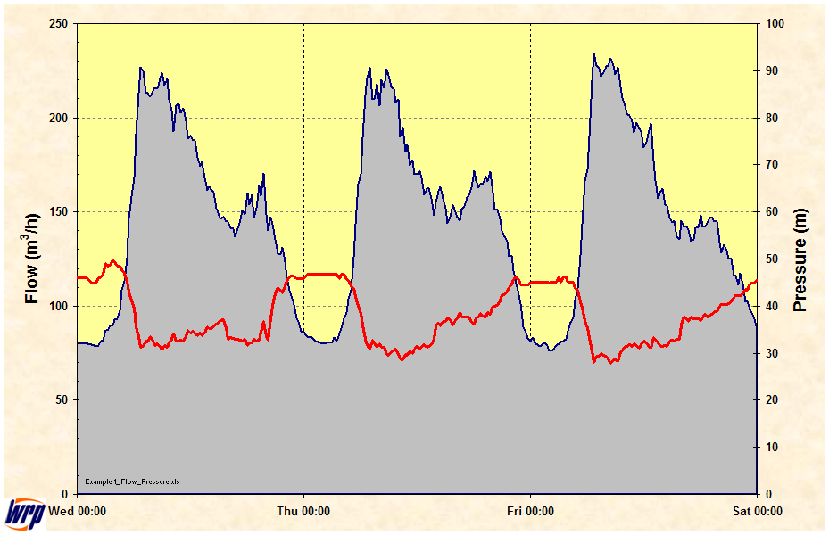
1: Typical flow and pressure logging
Flow
Pressure

Slide 18
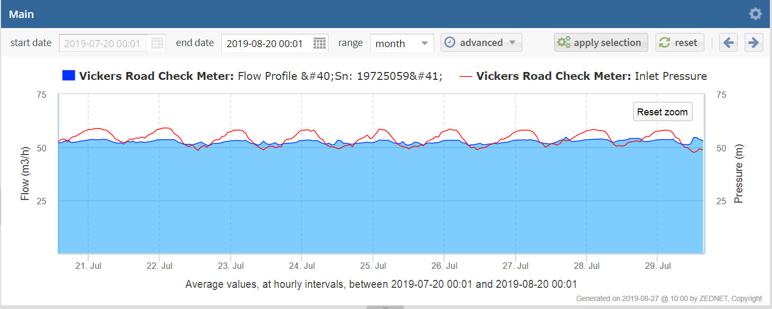

Slide 19
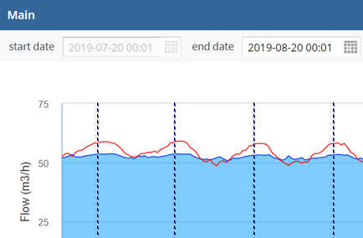
Minimum Day Flow: A new Concept ???

Slide 20

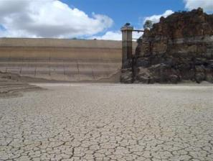
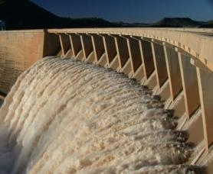
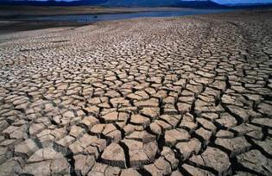

Slide 21
Origins of Models
Based on ARSP Model from Canada – 1983
Prof Loucks – Cornell
Prof Stedinger – Cornell
Prof Grieg – Colorado State
Resource Software design originally in FORTRAN
Stochastic Software by Prof Pegram : University of Natal.

Slide 22
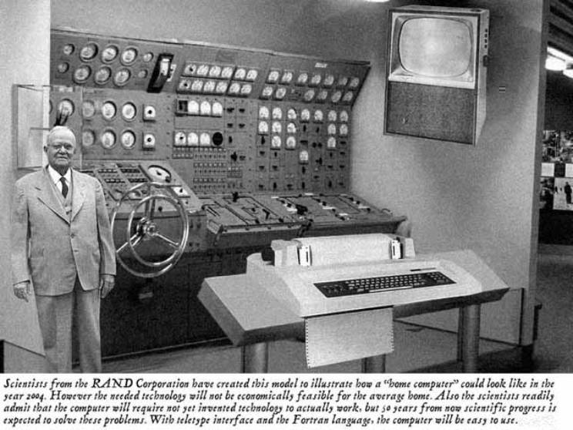
A mock-up of how scientists thought a home computer would look in the year 2004 as suggested by the RAND Corporation in 1954

Slide 23
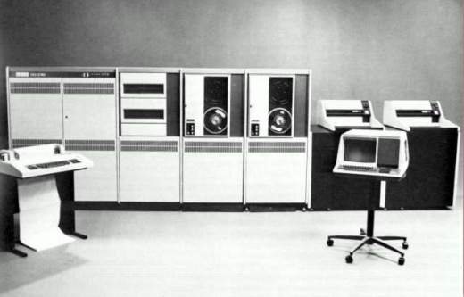
VAX 780 (1983)

Slide 24
Creating a System Model

Slide 25
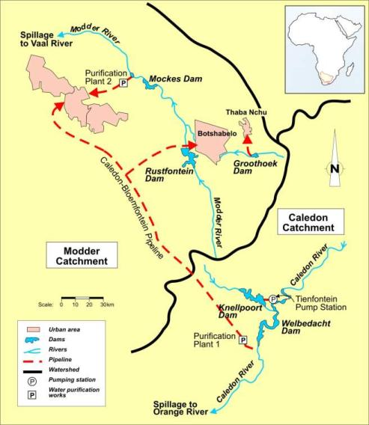
Typical simple water resource system

Slide 26
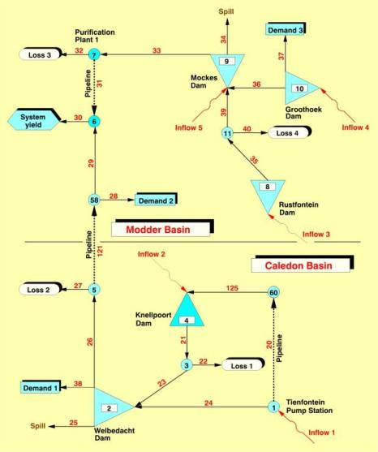
Initial System Model

Slide 27
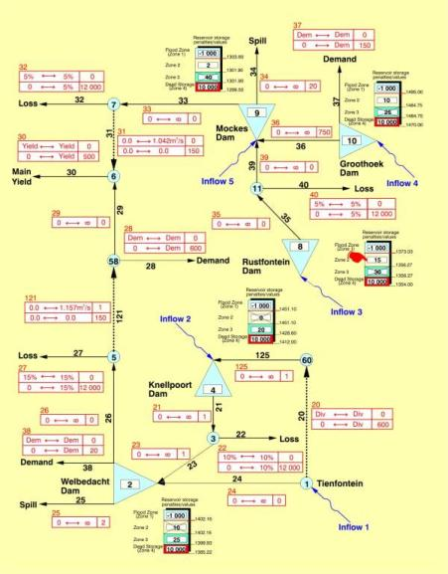
Penalty Structures
Added

Slide 28
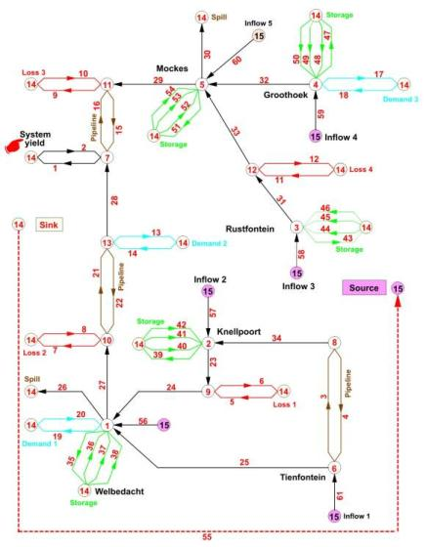
Internal Node and arc network
(storage reservoirs converted to flow arcs allowing each time interval to be solved using an “Out of Kilter” LP solver)

Slide 29
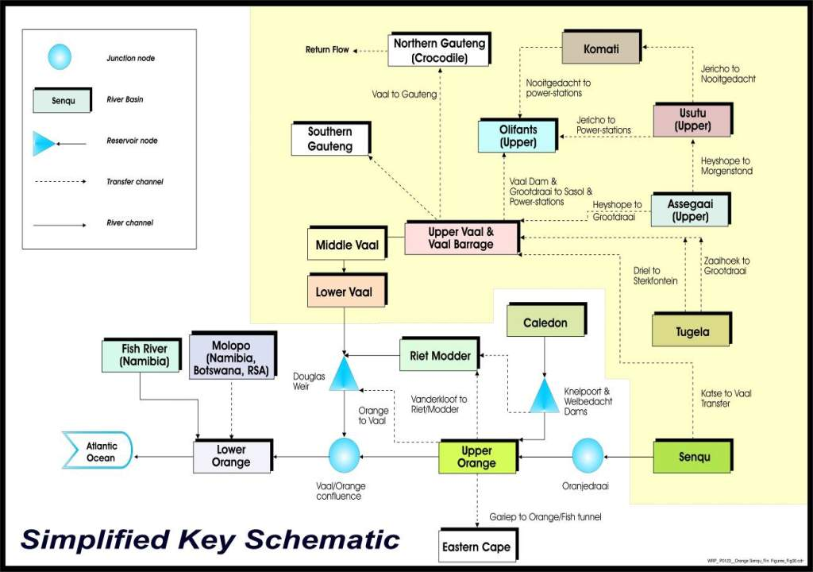
Integrated Orange /Vaal system
Thank You

Slide 30
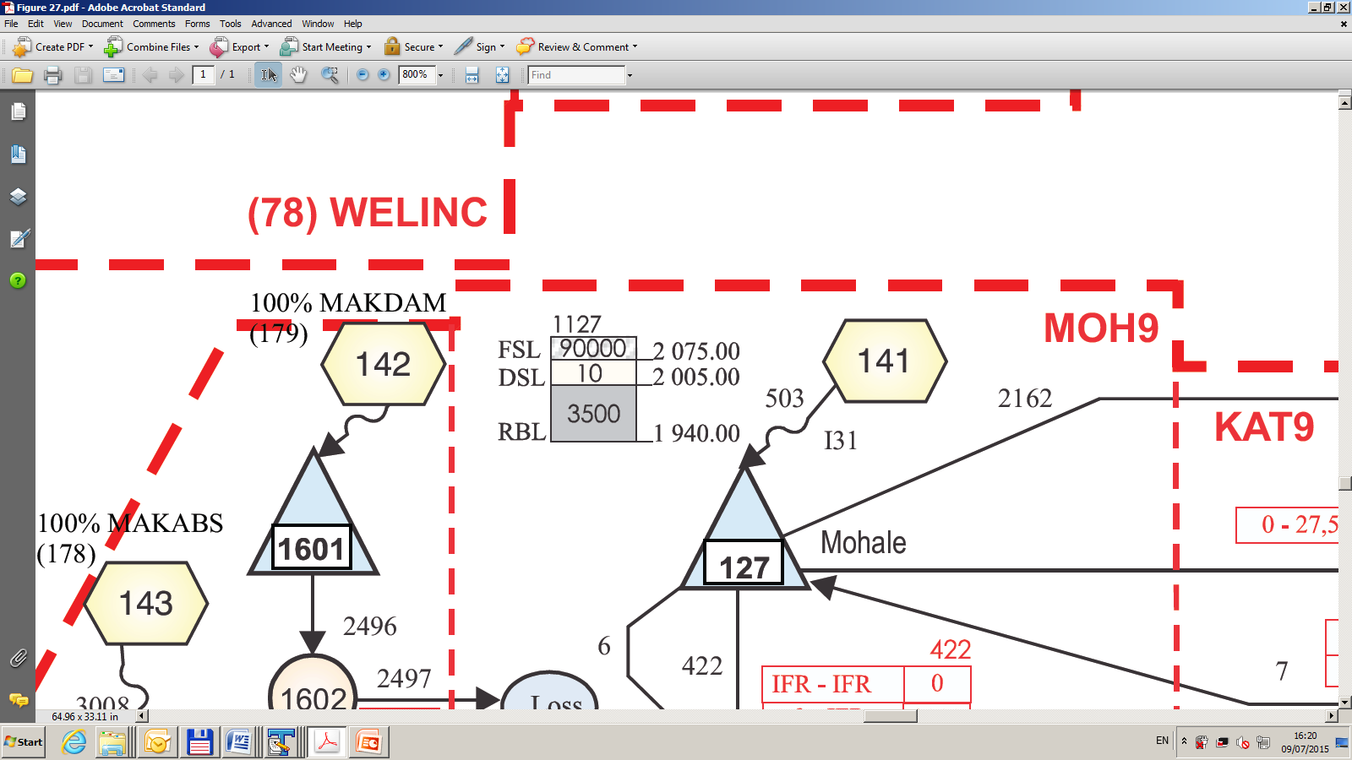
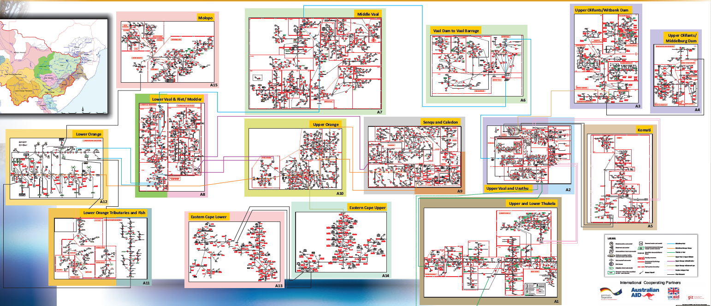
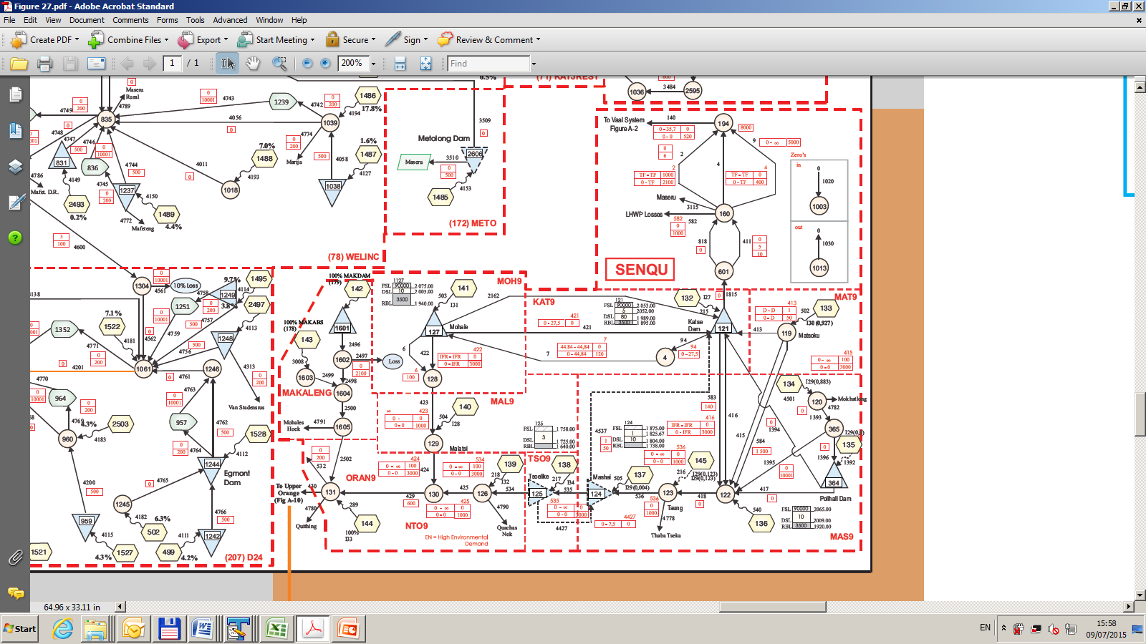
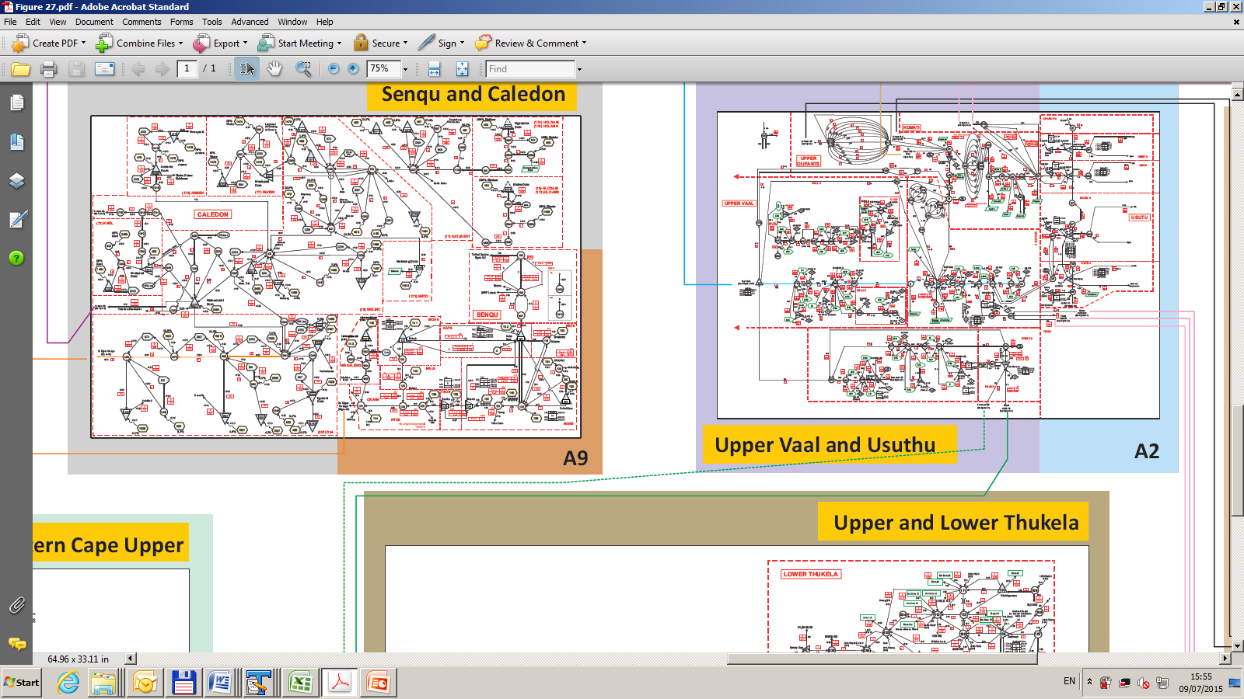

Slide 31
Orange/Senqu Water Resource System
87 Large Dams
279 Small Dams
± 1 250 Abstractions/Demand Centres
8 integrated subsystems
± 4 000 channels/arcs
Over 300 naturalized streamflow records
Over 300 point rainfall time series

Slide 32
Naturalization of Hydrology

Slide 33
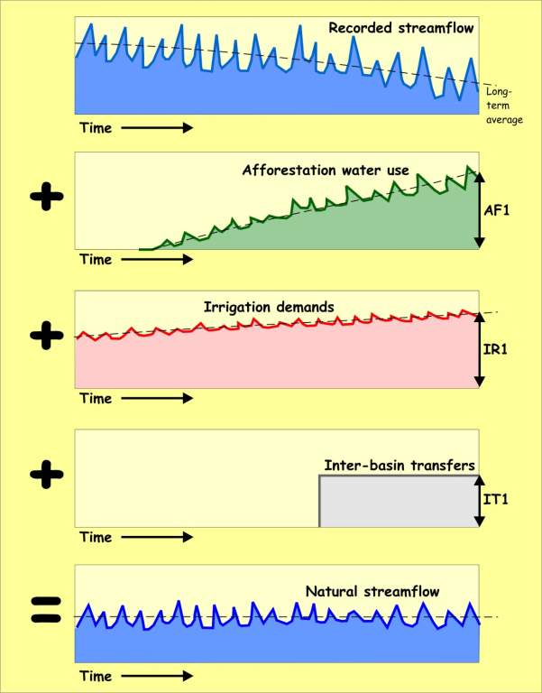
Naturalization of Streamflow Data

Slide 34
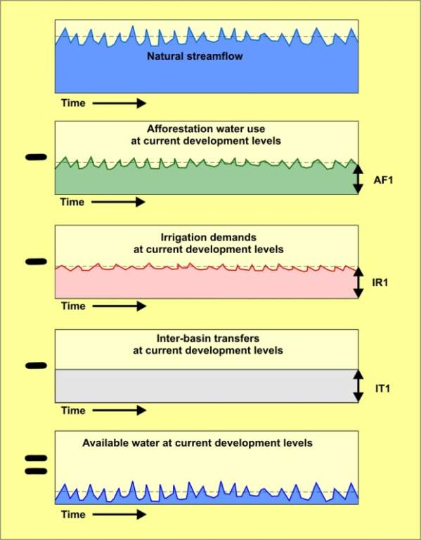
Streamflow Record at Current Development
Levels

Slide 35
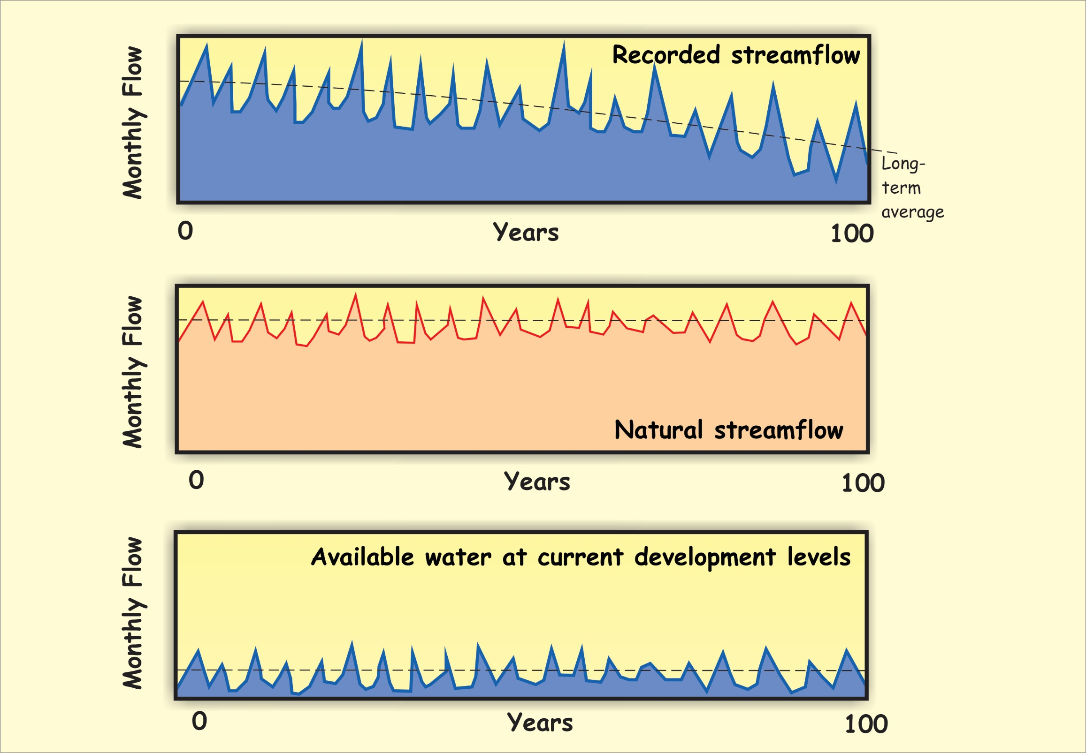
Streamflow Record at Current Development
Levels

Slide 36
Use of Stochastic Hydrology

Slide 37
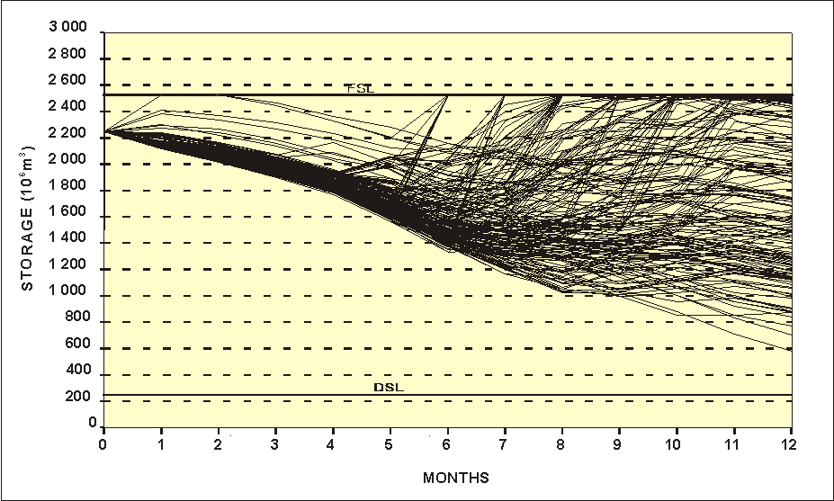
Projected system volume trajectories

Slide 38
Min %
5.0 %
25 %
50 %
75 %
95 %
Max %
Percentage of sequence results exceeding given value
Results for sequences

Slide 39
Projected system volume trajectories

Slide 40
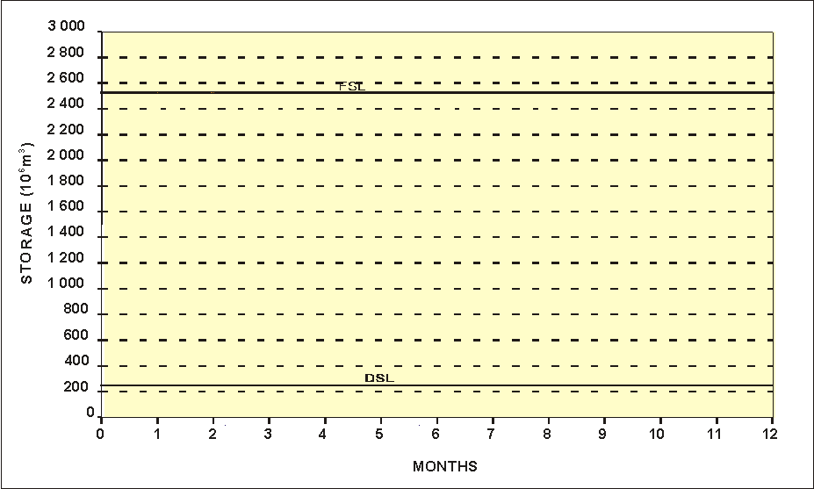
Projected system volume trajectories

Slide 41
Restrictions
lifted
Restrictions
imposed
Historical
reservoir levels
Levels below which
curtailments are imposed

Slide 42
Vaal System Storage at April 2019
Slide Courtesy DWS AOA
42

Slide 43
Grootdraai Dam
Slide Courtesy DWS AOA
43

Slide 44
Sterkfontein Dam
Slide Courtesy DWS AOA
44

Slide 45
Main Lesotho Reservoirs
45

Slide 47


Slide 48
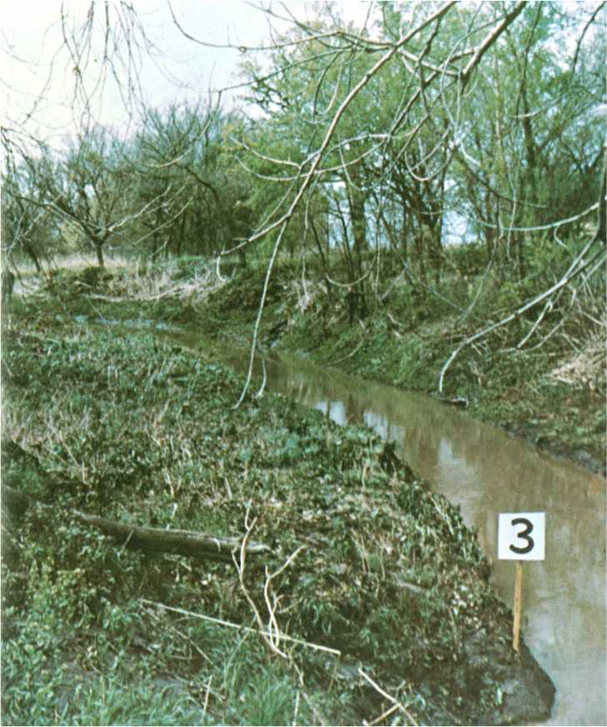
n = 0.030

Slide 49
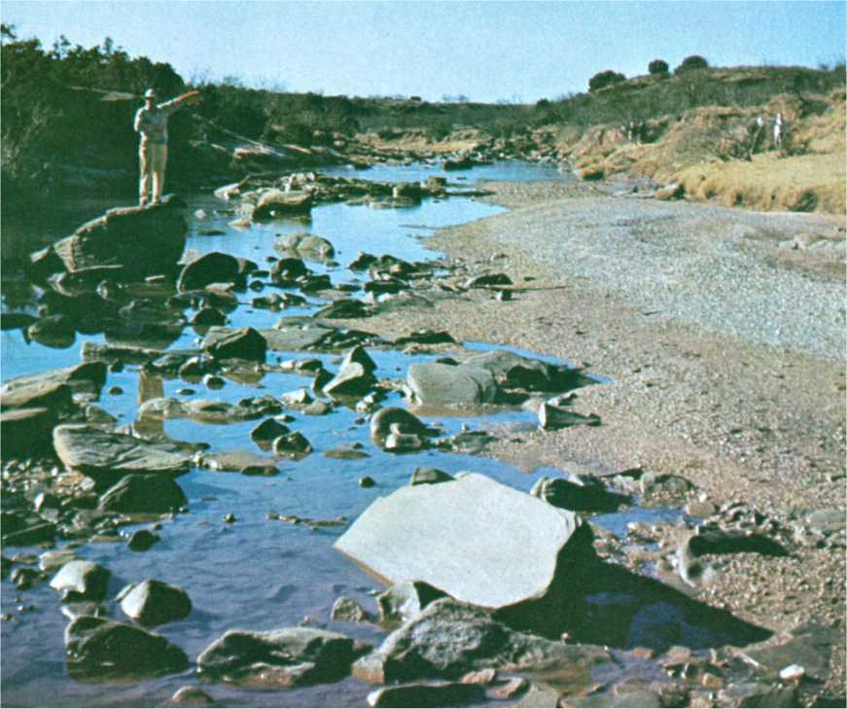
n = 0.040

Slide 50
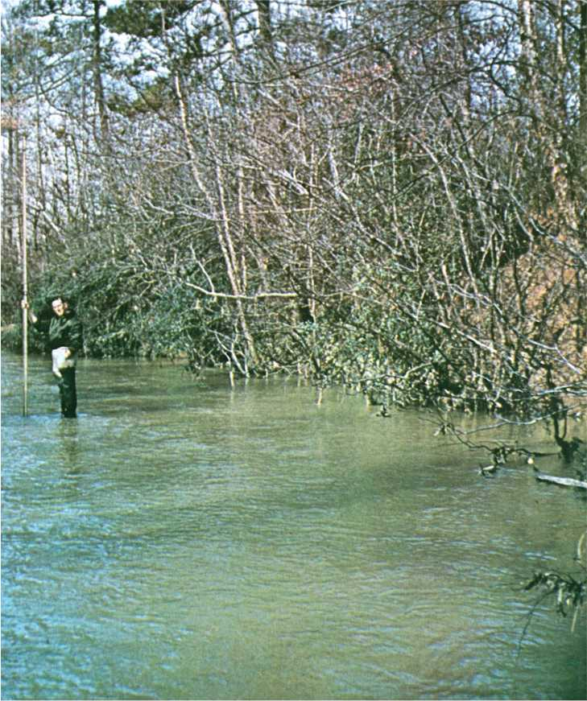
n = 0.050

Slide 51
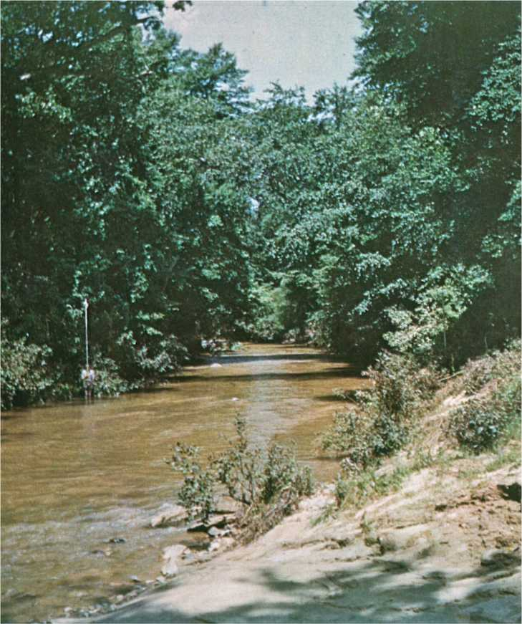
n = 0.060

Slide 52
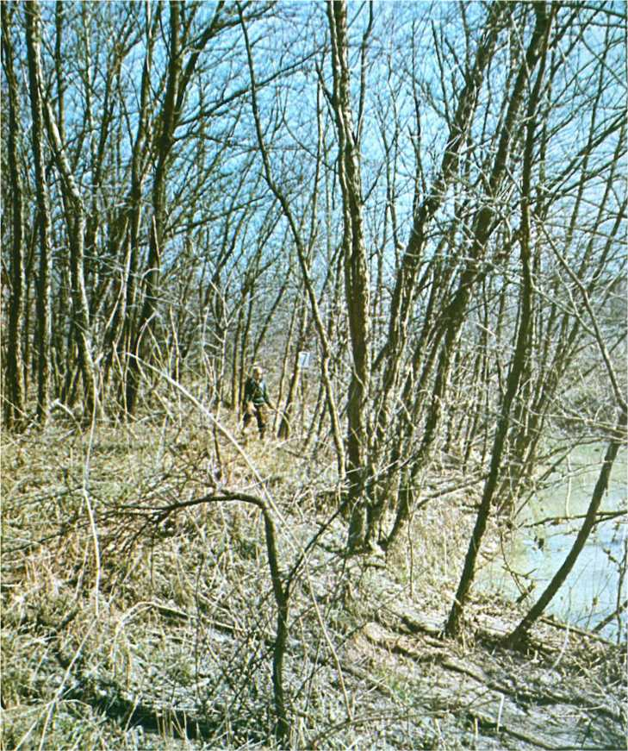
n = 0.070

Slide 53
How much water is lost from a leak ?
Leakage rates for various mains bursts ???
Pipe | System | Leakage Rate |  | Leakage | Water
Diameter | Pressure |  |  | Duration | Lost
mm | m | m3/s | m3/hr | Hours | m3
100 | 50 | 0.2459 | 885 | 2.00 | 1770
100 | 80 | 0.3110 | 1120 | 1.58 | 1769
150 | 60 | 0.6060 | 2182 | 2.48 | 5410
150 | 70 | 0.6546 | 2356 | 1.04 | 2451
100 | 90 | 0.3299 | 1188 | 1.79 | 2126
100 | 90 | 0.3299 | 1188 | 1.41 | 1675
100 | 80 | 0.3110 | 1120 | 1.20 | 1344
100 | 90 | 0.3299 | 1188 | 2.09 | 2482
150 | 30 | 0.4285 | 1543 | 5.15 | 7944
250 | 60 | 1.6833 | 6060 | 2.00 | 12120
 |  |  |  |  | 39091

Slide 54
Typical burst flow rates at 50m pressure

Slide 55
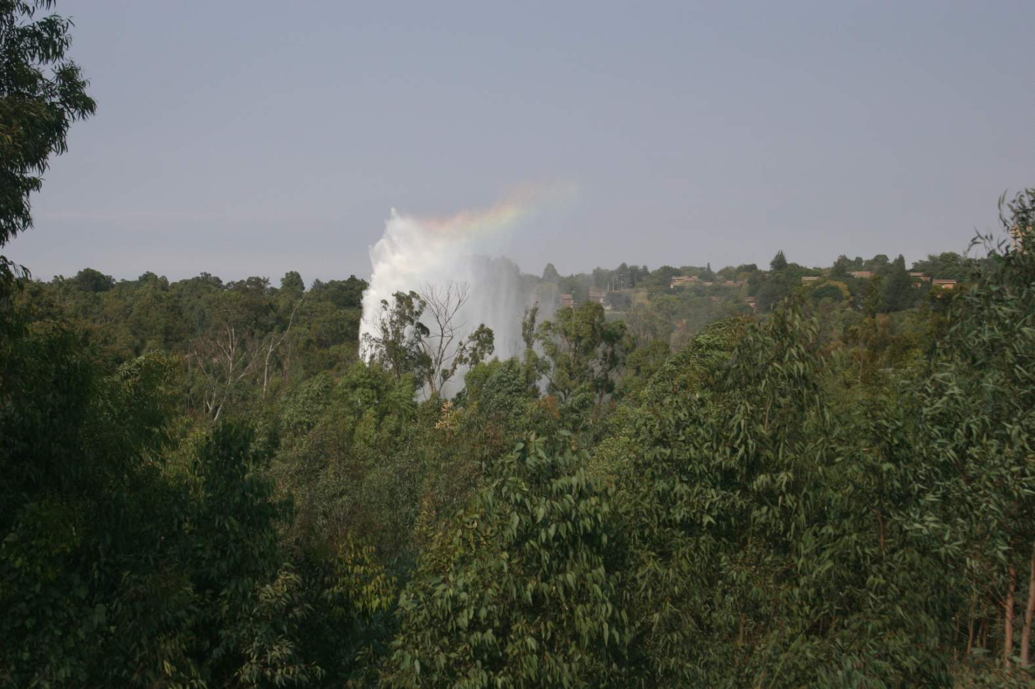
200 m³/hr for 3 hours = 600 m³

Slide 56
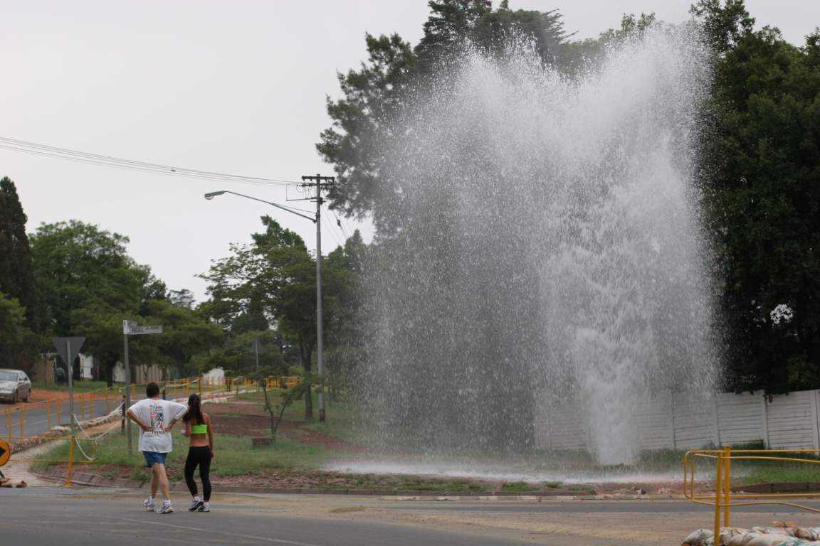
40 m³/hr for 6 hours = 240 m³

Slide 57
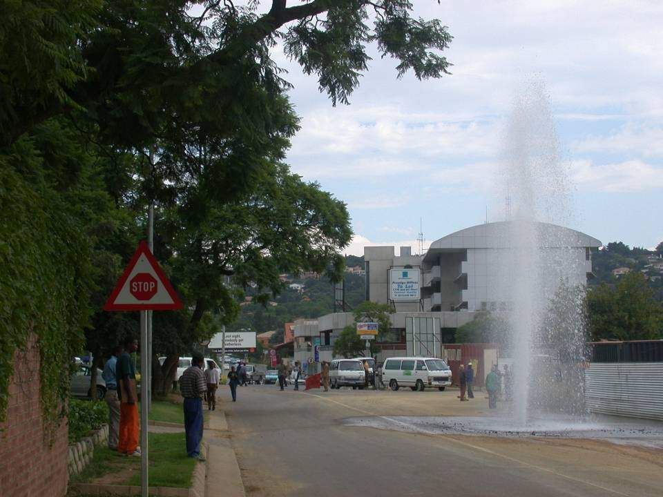
20 m³/hr for 3 hours = 60 m³

Slide 58
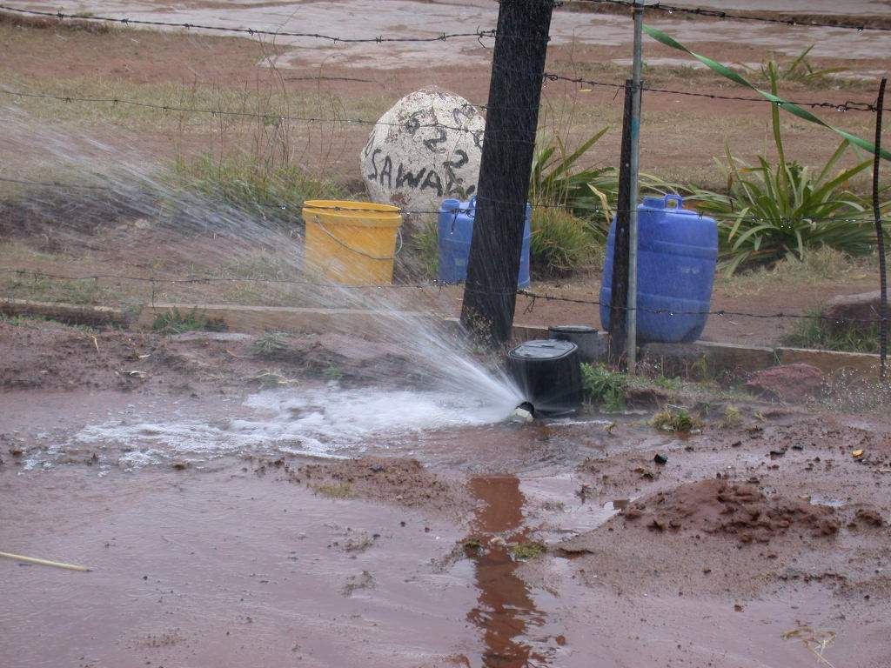
1 m³/hr for 3 months = 2 232 m³

Slide 59


Sprinkler at approximately 1 m3/hr
Notes:
59

Slide 60


0.5 m³/hr for 3 years = 13 140 m³

Slide 61


Photos: Courtesy Caryn Seago

Slide 62

Photo: Courtesy Tim Waldron

Slide 63

Photo: Courtesy Trevor Westman

Slide 64


Slide 65
How much water is used in a household ?

Slide 66

Dual Water
meter

Slide 67

42 m³ over 3 months
= 14 m³ /month @ R5/m³
= ± R70/month
619 m³ over 3 months
= ± 200 m³ /month @ R5/m³
= ± R1000/month

Slide 68

Leaking tap at approximately 250 litres/hr (200 m3/month)

Slide 69

Leaking hose at toilet cistern of approximately 100 litres/hr

Slide 70

Low income area – No Payment for water
Average water use of > 60 m³/month

Slide 71

High income area – full payment for water
Average use ± 15 m³/month if no pool or irrigation

Slide 72

Catastrophic Failure of 600mm Bulk Main

Slide 73
20 m³/hr

Slide 74

20 m³/hr = MMMI of 1/month
(The Mike Mercedes Index: Courtesy Prof. Mike Muller)
In 1 month

Slide 75
20 m³/hr = MMMI of 12/year
(The Mike Muller Mercedes Index: Courtesy Prof. Mike Muller)
In 1 year

Slide 76
Some background to Water Loss Management in South Africa

Slide 77





4 WRC
MODELS

Slide 78





Slide 79
Night Flow Analysis

Slide 80
Analysis of minimum night flow logging results from SANFLOW
First of the BABE Models to incorporate error sensitivity

Slide 81

Interpretation of MNF
Notes:
Notes:
In order to establish if a zone has leakage problems it is necessary to split the MNF into its various components:
Burst leakage;
Background leakage;
Legitimate night use.
The burst and background leakage are then spilt into three components that are measured or estimated using standard figures:
Mains leakage;
Connection pipe leakage;
Property leakage.
The components of background leakage are estimated using:
Length of mains;
Number of connections;
Some basic leakage parameters selected to suit the particular system being analysed.
The legitimate night use is estimated from the population, toilet cistern size and information on any large users, etc.
Having calculated or estimated the background leakage and legitimate night use, the burst leakage can then be established as the difference between the MNF and the sum of the legitimate use and background leakage

Slide 82
Pressure Management

Slide 83

Low Pressure
Photo: Courtesy Ken Brothers

Slide 84

Photo: Courtesy Ken Brothers
High Pressure

Slide 85


Slide 86


Slide 87


Slide 88

Estimated Damage = ± $15 million

Slide 89
Analysis of pressure logging results can be undertaken using PRESMAC
Assessment of potential savings from various forms of advanced pressure control

Slide 90




Pressure Analysis

Slide 94
© WRP (Pty) Ltd, 2001

Slide 95


Khayelitsha : 2000

Slide 96
Khayelitsha
± 70 000 stands
± 110 000 households
Average pressure 60m to 80m
Over 450 000 residents

Slide 97


Slide 98

Photo Courtesy Tertius de Jager

Slide 99

Hourly: Savings = 1000 m³/hr
Olympic swimming pool every 2 hours

Slide 100

Sebokeng : 2005

Slide 101
Direction of Flow
To Evaton
Direction of Flow
From Rand Water
Direction of Flow
From Rand Water
Lower Pressure to Sebokeng & Evaton
During off-peak periods
High Pressure from Rand Water
Direction of Flow
To Sebokeng
Direction of Flow
From Rand Water
Direction of Flow
From Rand Water

Slide 102


Slide 103


Photo courtesy Technolog

Slide 104
Sebokeng Savings
Saving ± 10 million m3 per annum (± 27 Ml/day)

Slide 105

Mitchells Plain : 2009
Photo Courtesy Tertius de Jager of CoCT

Slide 106


Details for 1220 mm Ø PRV Chamber

Slide 107

Photo courtesy Technolog

Slide 108
Water Balance

Slide 109
First Excel based Water Balance Model based on the Standard IWA Water Balance Methodology

Slide 110

Modified IWA Water Balance to Allow for Free Basic Water Component in SA

Slide 111
Economics of Leak Location

Slide 112
Assessment of the most appropriate level of Active Leakage Control based on BABE Principles

Slide 113
What about Leakage ?
New Technology – High Tech

Slide 114

Leak Location by Satellite
( 300% increase in satellites by 2024)

Slide 115


Slide 116

Leaking Connection on Narmada pipeline

Slide 117
What about Leakage ?
New Technology – Low Tech

Slide 118


Slide 119


Large Canine Leak Detector(LCLD) for Mains Leaks
Photo: Courtesy United Utilities

Slide 120


Small Canine Leak Detector (SCLD) for Connection Leaks

Slide 121



Slide 122


Slide 123
Continuous Monitoring

Slide 124


Slide 125
Some Logging Results

Slide 126

2 : Interpretation of flow logging
● Stable domestic flow pattern – main peak in morning
● Average daily flow = ± 150 m³/hr
● Minimum night flow = ± 80 m³/hr
● MNF/ADD = ± 53% indicating possible leakage problem

Slide 127

Leak running at ± 1.6 m3/hr for 10 days
Leak develops
Leakage
Leak repair
Cost of leak
± 10 * 24 * 1.6 * 20
= ±R8 000 in 10 days

Slide 128

Industry 2 Leak – Before and After

Slide 129

Leak Repaired at Townhouse Complex

Slide 130


Slide 132


After
Before

Slide 133

Average water use 41 m3/hr
Average water use 16 m3/hr

Slide 134

Intermittent Supply : Don’t go there !
Average Flow = 17.4 m³/hr
Average Flow = 14.0 m³/hr

Slide 135

Office Park - Flow

Slide 136

Growing leak at office complex

Slide 137

Leak identification and repair at Office Park

Slide 138
Intermittent Supply

Slide 139

Mixture of Sewage
& Potable Water

Slide 140


Intermittent Supply
Flow
● rapid refilling of empty pipes
● No supply during night
● MNF = ± 165 m³/hr
● ADD = ± 200 m³/hr
● MNF/ADD = ± 83%

Slide 141
Initial Avg Flow : 135 m3/hr

Slide 142
Initial Avg Flow : 135 m3/hr
Reduced Avg Flow : 95 m3/hr

Slide 143
Comments from Bambos Charalambous
(IWA: Bangalore 2016)
Intermittent supply is not an appropriate response to drought or water shortage
It takes 1 hour to switch to intermittent supply but 2 years to return to 24/7 (at great cost)

Slide 144
Recommendations
Try everything else before introducing intermittent supply
Intermittent supply is the measure of last resort
Rather reduce water pressure but try to maintain 24/7
Take action early on in a drought
Take action now to reduce wastage

Slide 145
Climate Change
What is happening and what impact will it have on water resources ?

Slide 146


Slide 147


Slide 148


Slide 149
Climate Change
Clear evidence that the climate is changing.
Difficult to quantify or predict the influence of future Climate Change on rainfall and streamflow
What is the impact of land use change relative to Climate Change ?
Christiana Figueres (Sky News 28 October 2015) “ Natural disasters are not caused by Climate Change but the intensity and frequency of such disasters are exacerbated by Climate Change”

Slide 150
Example calculation of CO2 savings

Slide 151

Solar Panels Installed at an Embassy in Pretoria

Slide 152

Cost of the Panels ± R8 mil (± $1 mil)

Slide 153

Panels Save ± 90 Tonnes CO2 Per Annum

Slide 154
Pressure Management v Embassy Solar Panels
Pressure Management
Capital Cost R5 mil ($650 k)
Saves 13 000 tonnes CO2/yr
Value of CO2 = R2.1 mil/a
Water savings R30 mil/a
Interest R500 000/a
Payback less than 3 months
Solar Panels at Embassy
Capital Cost R8 mil ($1 mil)
Saves 90 tonnes CO2/yr
Value of CO2 = R18 000
Electricity savings R300 000/a
Interest R800 000/a
Payback NEVER !!
Note: The figures are for this specific example and figures may vary from case to case

Slide 155
Enhancing Water Security
Water Resource Management: Priorities
Continue to plan using risk based approach
Agree on acceptable risks for each demand
Implement restrictions early in drought cycle
Facilitate water market.

Slide 156
Water Use Efficiency: Priorities
Repair reported leaks quickly
Reduce pressure (pressure creates leakage)
Use Tariffs to curtail demand in emergencies
Change behaviour on water use
Do not introduce intermittent supply
Consider leakage as cheapest new resource

Slide 157
THE END

